Slide 1
Railroad-track rehabilitation on Aquatic Park’s southeast shore: Before -- and what next
Susan Schwartz, Friends of Five Creeks, f5creeks@gmail.com
Railroad tracks edged Berkeley’s southern shoreline from the 1870s --the city’s goal was an industrial waterfront. In the Great Depression of the 1930s, however, Berkeley accepted federal grants and jobs to dredge what is now the Berkeley Marina, build the first version of today’s I-80 as an offshore feeder to the new Bay Bridge, and create Aquatic Park in the shallow finger of Bay cut off by this new highway. Details on the park’s creation are here.
The transcontinental railroad, now the Union Pacific (UPRR), for decades has sought to rebuild a bottleneck underpass at the Port of Oakland. This requires what a stretch of tracks where trains can wait or be reshuffled. Today’s rails, however, are hemmed in by urban development, including vital buried sewer, water, fuel, and communications lines.
The choice was Aquatic Park south of Dreamland for Kids Playground (north of Dwight Way). Here, two sets of rusty, disused tracks were edged with tall eucalyptus trees that could fall onto trains. The railroad owns a wide right-of-way down the former shoreline bluff , well into the little-developed park below. West Berkeley groundwater, percolating through the grade, comes out in the park as springs or wetlands. These form small creeklets that flow to the lagoon, and support trees and bushes that hid much of the industrial development just inland. Most visitors thought of this as park, enjoying the greenery as well as the water.
Berkeley missed or ignored notifications for at least three years. As a result, it had no voice as the plans proceeded through the Alameda Transportation Commission. Back in 2000, the UPRR obtained a letter from the (then) Department of Fish and Game conceding that it had no power. The San Francisco Bay Regional Water Quality Control Board (Waterboard) retained some authority -- limited by exemptions for vital transportation and infrastructure. They obtained agreements that narrowed the area to be widened and re-graded. They also wanted the railroad to compensation for coming damage to Aquatic Park through extensive naturalization and planting along the tracks in Albany, north of Codornices Creek. In May 2024, however, the railroad proposed a new plan and new map, with far less wetland recognized. Its work, it said, would cause only temporary harms, requiring protecting and rehabilitating only small areas of wetlands, where it offered a handful of old photos as the goal. One creeklets, near Grayson, would get a few new trees, a short retaining wall, and protecting and re-planting 73 feet of channel. The Waterboard approved and certified the project in December 2024. The U.S. EPA and Army Corps followed. Berkeley apparently knew nothing.
In early April 2026, disc golfers saw construction stakes and notices and called the city in alarm. Hasty closed meetings among agencies have followed. As of June 2026, clearing may be complete. Masses of fallen wood and bruah are piled on the grade, waiting to be taken out eastward across the tracks. Large industrial buildings, no longer screened, dominate what visitors see. The railroad evidently has promised Berkeley some money for planting, but this probably is not yet formalized. Areas where the railroad has promised rehabilitation are less than those already affected. This short slide show, to be updated, aims to record and track what happens.

Slide 2
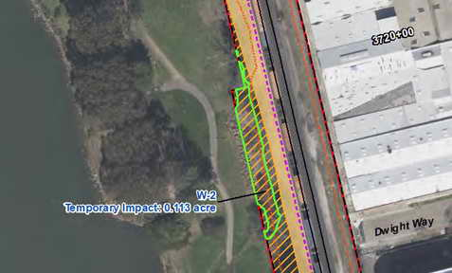
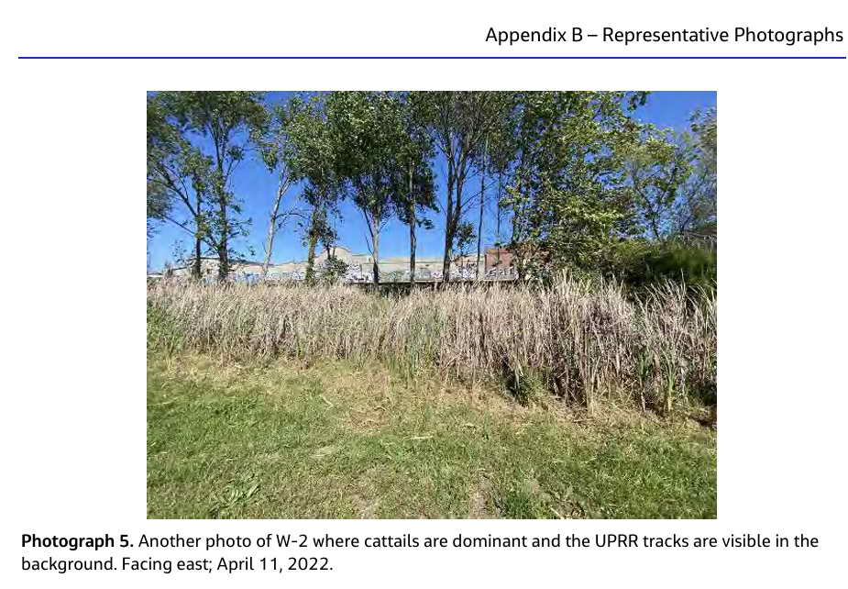
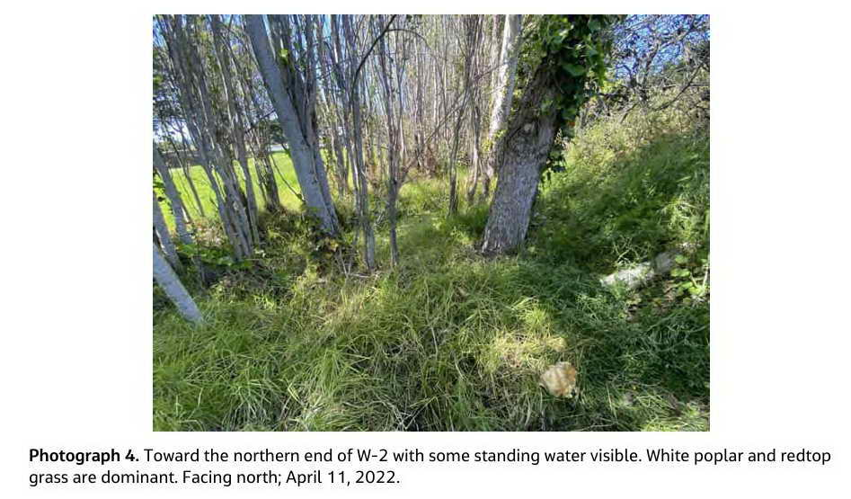
Clearing began in May, from the north, south of Dreamland for Kids playground. Here a long stretch of cattails, feeding small creeks, gave way near the west end of Dwight Way to dense, marshy trees and brush, feeding more creeks. Plans call this area W2. (Left, figure from approved Waterboard permit). Just over a tenth of an acre is supposed to be affected, and only temporarily.
The railroad’s approved application includes eight photos to be used to show pre-project conditions and measure successful rehabilitation. These begin with #4, left below, and #5, right below.

Slide 3
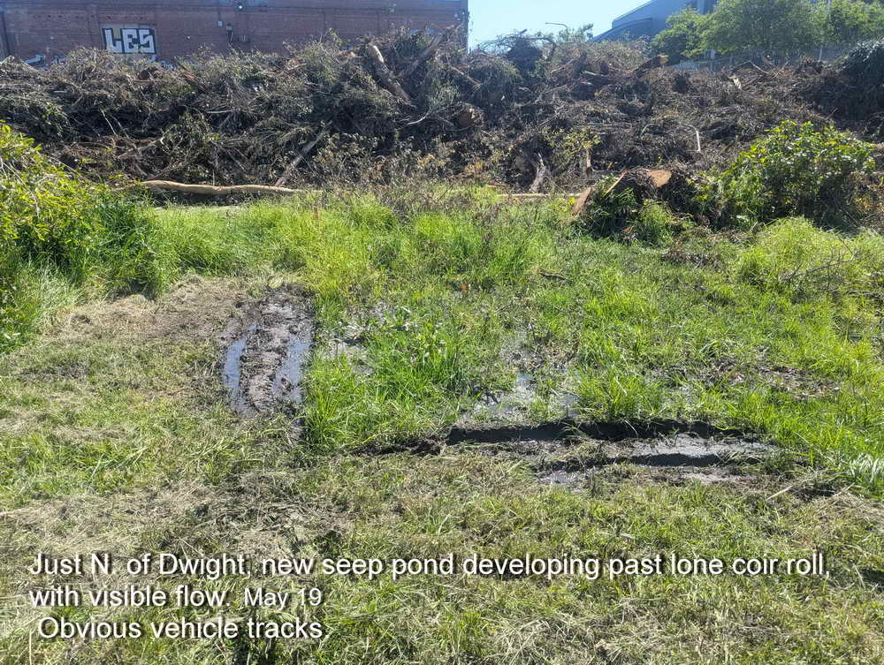
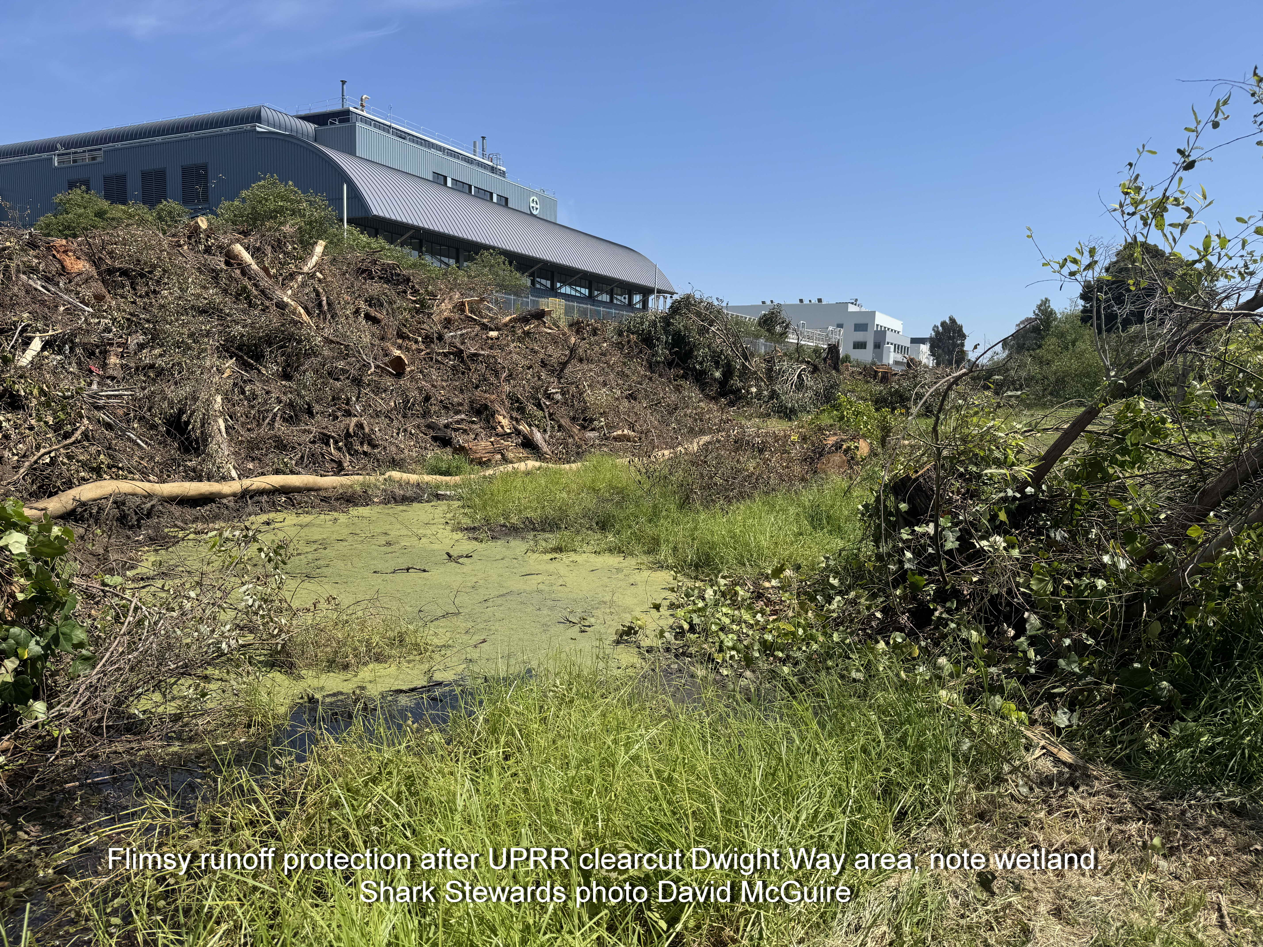
The railroad grade and its foot in the park so far show significant effects, and threats of more, from clearing. The industrial buildings flanking Dwight Way are no longer screened. (Dwight Way is the break between the masonry and blue buildings. The approved plans promise erosion control and other protections, but it is not clear when.
Left below: A new seep pond seems to be developing beyond the old one (covered in duckweed). Fresh tire tracks could become a new channel fed by springs in the grade.
Right below: The single fiber roll might not offer much protection in a late rain or other disturbance to the huge, steep woodpile.

Slide 4
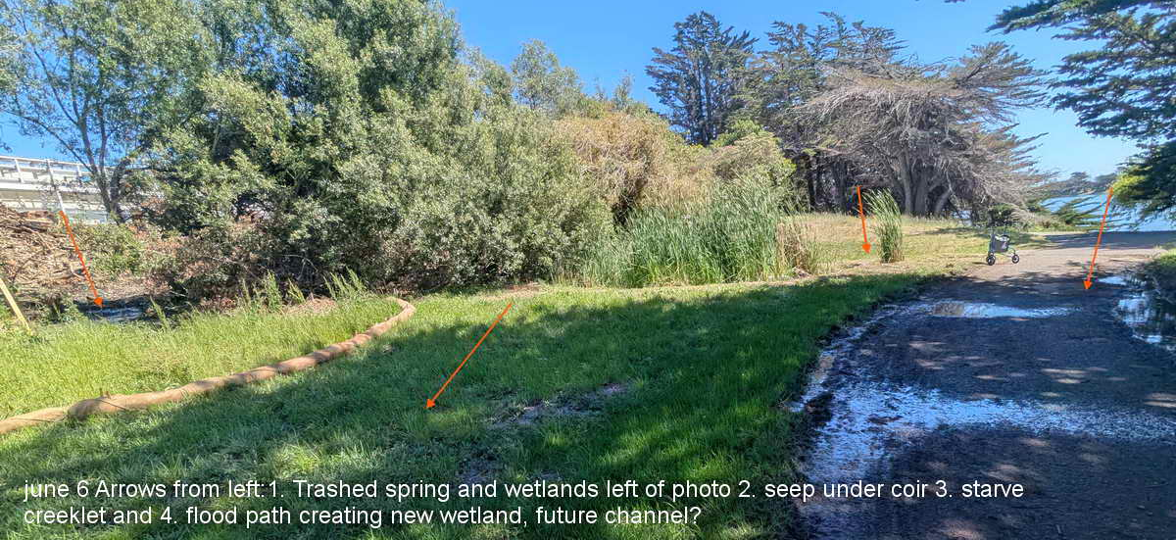
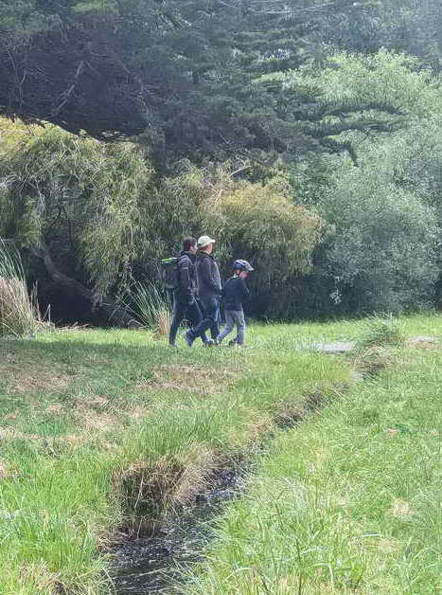
Permits do not recognize the existence of any creeks in W2 or in much longer W3 or W4, longer wetlad areas farther south. Depending how you count, 3-5 creeklets flow from these areas to the main lagoon.
The largest (below left) has bridges and is clearly visible n Google Earth. It was fed by springs and shallow ponds in the dense brush, now trashed. Below: Arrows show where densely wooded springs were cleared. Their outflows immediately began re-forming and oozing under the lone coir roll. This has created a new wetland that is flooding the path. The creek itself (right arrow). This may form a new channel. The creek itself (The Imost spring and a single loop of coir. Water from these springs has flowed under this loop and is now flooding the path. This may lead to a new channel. The old creek (tufts of cattail near Rollator) appears to be losing some of its water as a result.

Slide 5
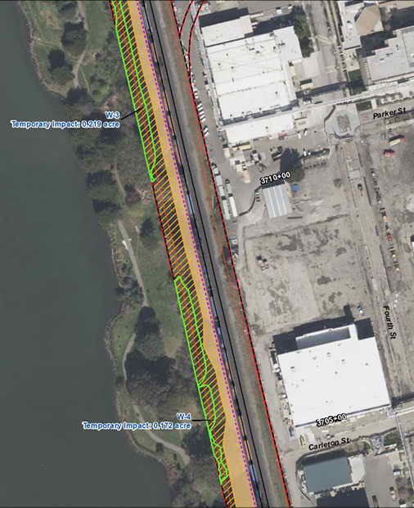
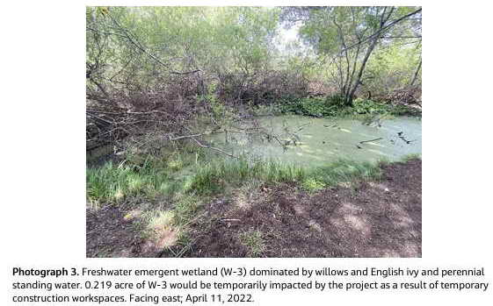
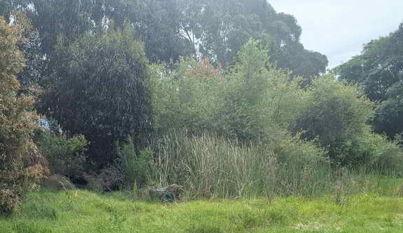
Right: Wetland areas W3 and W4 are mapped as running roughly from near the west end of Cutter Way (off the map) to south of Carleton, with a gap south of Parker. The 0.4 acres are expected to need rehabilitation include long, deep pools important for nesting waterbirds.
The approved plan does not provide guidance or funding (for example for trees). Its photo showing the target to aim (below left) aims low and does not reflect what these pools provide (below right).

Slide 6
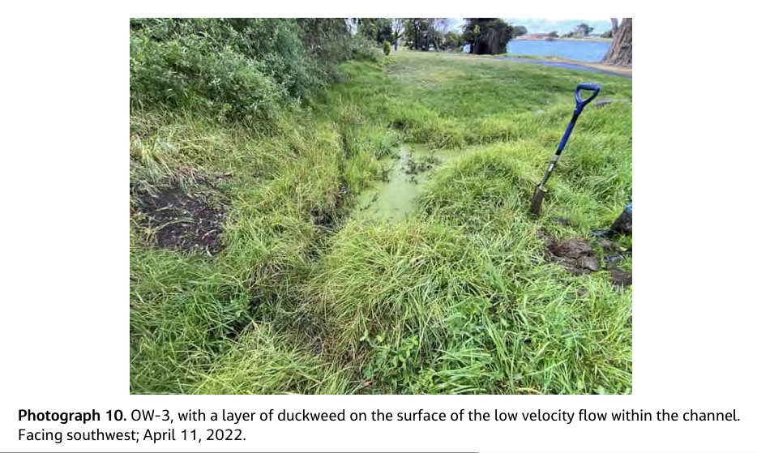
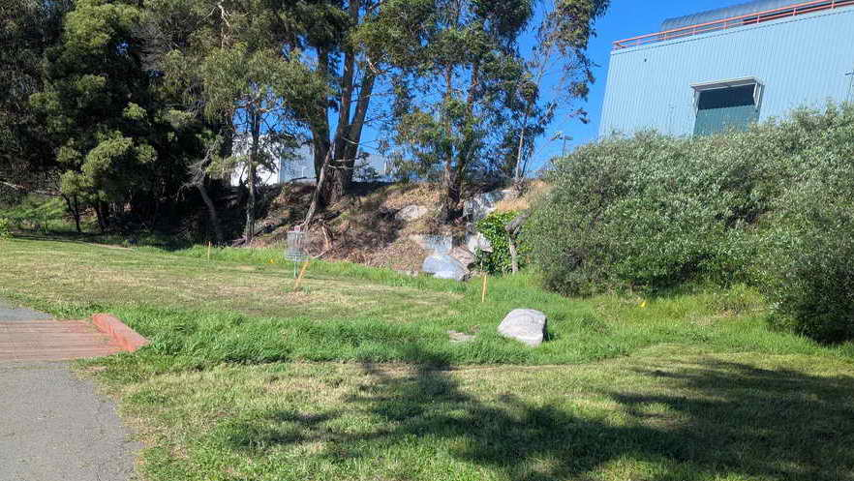
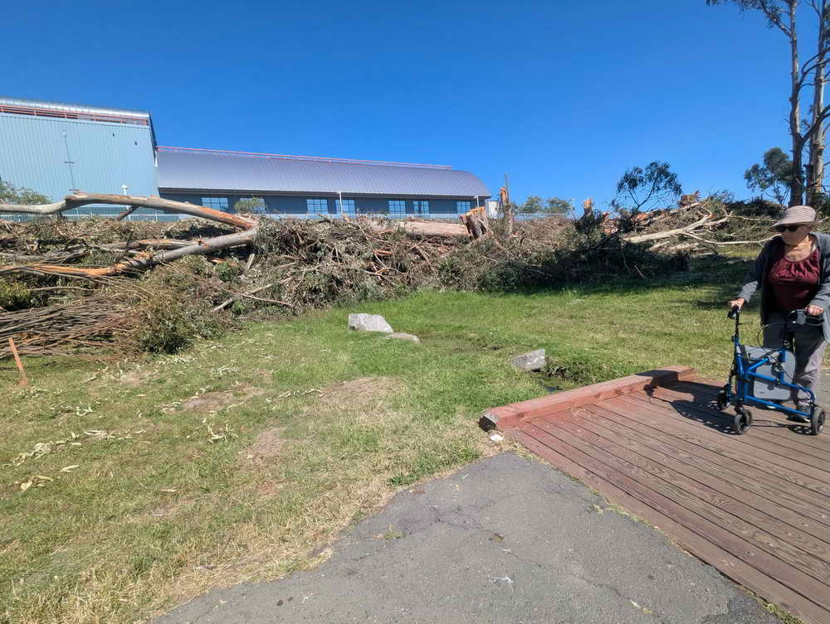
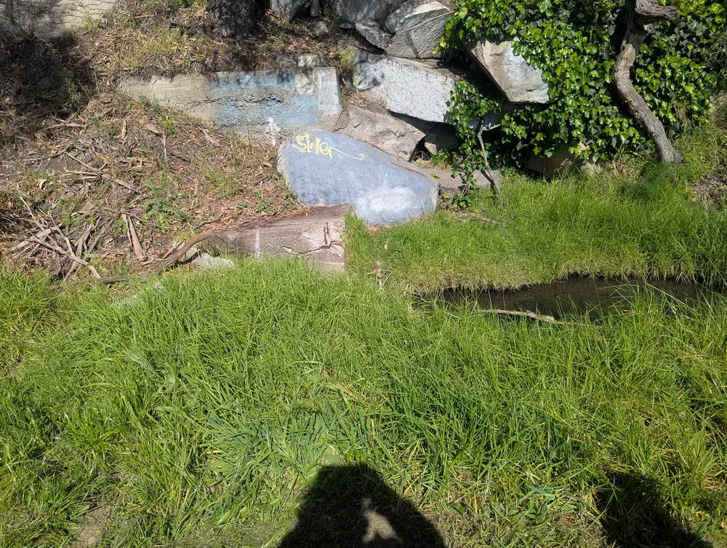
The only creeklet recognized in the plans is OW3, near Grayson. It is to be be protected by a short retaining wall , new trees, and 73 ft. of planting along its channel. Clockwise from above left: The railroad’s 2022 photo for measuring rehabilitation faces SW and shows little. Above right: Same creeklet April 2026, before clearing, facing NE toward tracks. Note slabs.
Right: Creeklet’s origin at slabs, pool just below, April 26.
Left, same creeklet June 5, 2026, after clearing. facing SE. No protection from silt or pollution is visible.

Slide 7
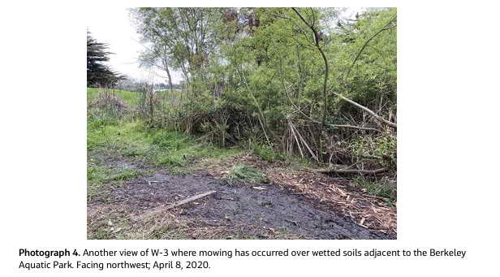
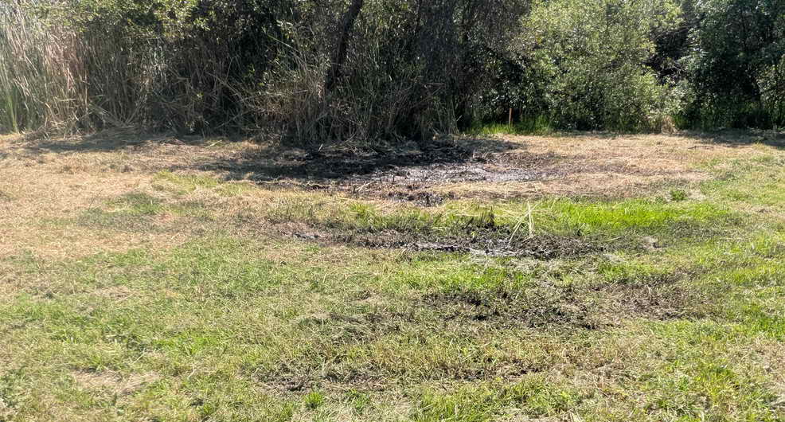
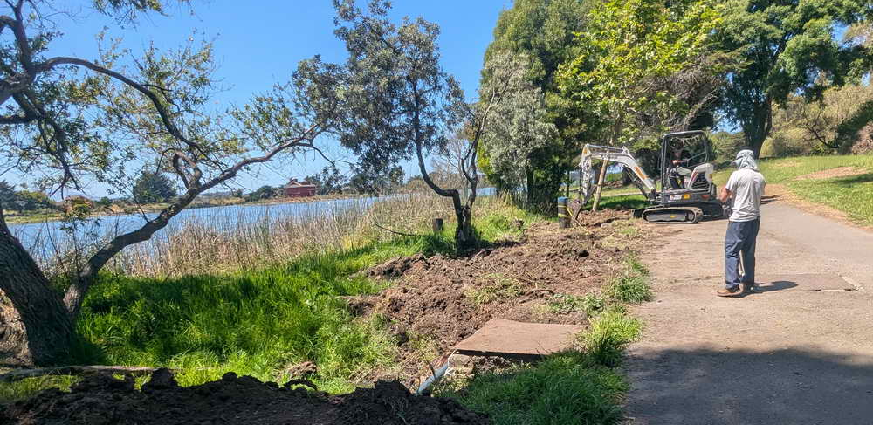
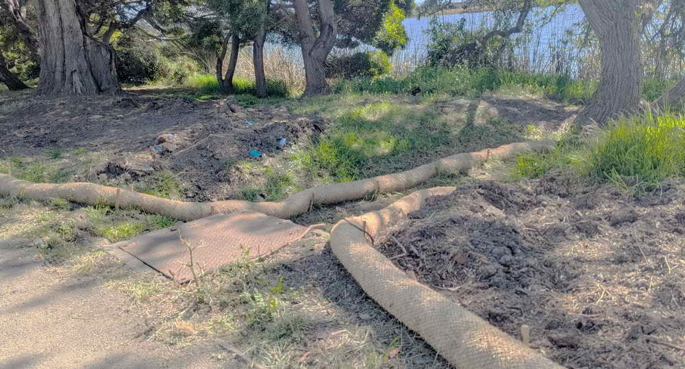
Would the Parks Department care for rehabilitated areas? Above left: The railroad saved one of its few photos from 2020. It shows poor stewardship: mowing over wetted soils. Above right: One of several May 19, 2026, photos showing freshly mowed cattails and mower tracks through mud. The Parks Department has a long history of neglecting or mowing over past attempts to create Aquatic Park habitat. The Waterboard has a long history of ignoring Aquatic Park (details available).
Below left: On May 19, 2026, Parks crew repaired a water-main leak near Parker that had been marked and reported since at least July 2025 (photos available). They left a swath of bare, loose soil near a creeklet’s channel to the lagoon.
Below right: Protection was installed after a Waterboard and railroad tour.

