Slide 1
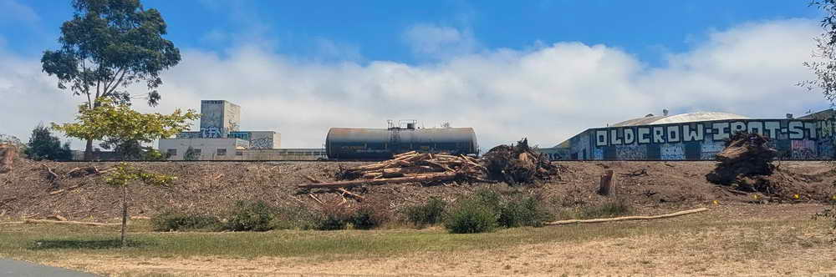
South Aquatic Park along the RR: industrial history returns, future uncertain
Photos Heinz to Parker, June 24 & 27
Below: Aquctic Park west of Grayson/Carleton street ends, June 27, with old industrial buildings including Macaulay Foundry, 100 years old when it closed. Firms in this area made industrial pumps, giant pipes, cars, airplanes, sulfuric acid (across the street from a school for children too young to walk far)….
Should they be remembered? Did they leave a toxic legacy?

Slide 2
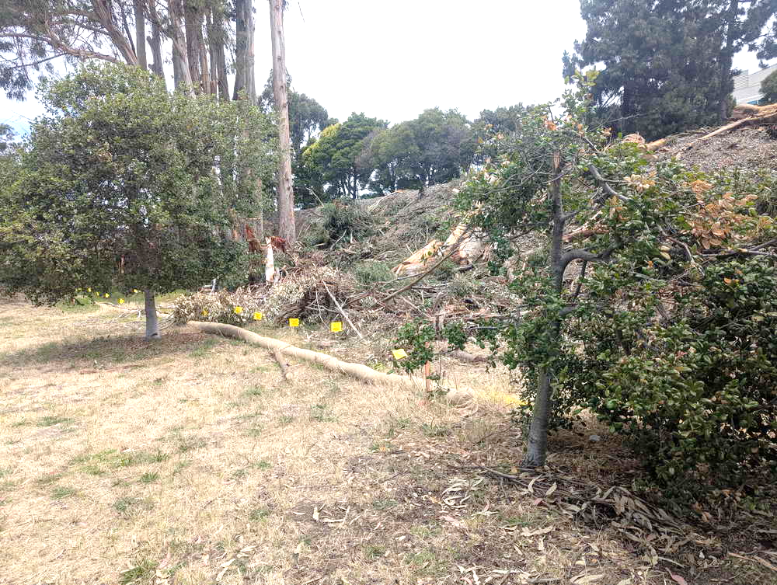
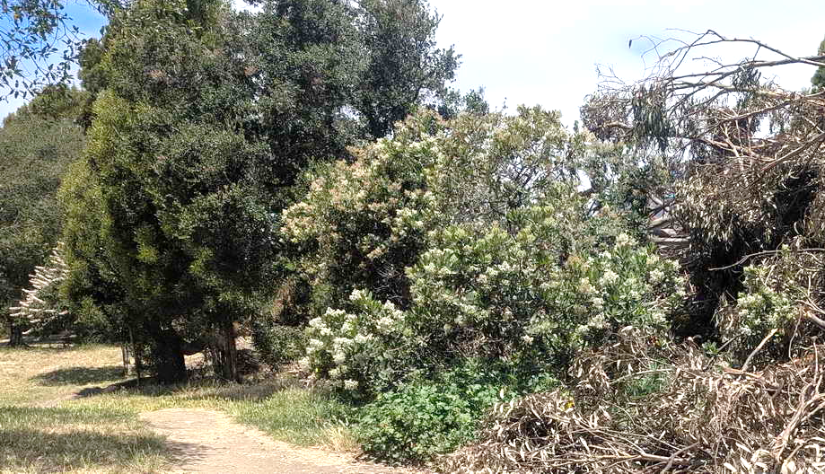
RR spared small oaks (left), big toyons and a buckeye. New park plantings, using grants promised by RR, can build on these.
The few taller non-native trees left standing are likely to be cut after nesting season.
The high-pressure fuel line (yellow flags) may restrict planting or building retaining walls.

Slide 3
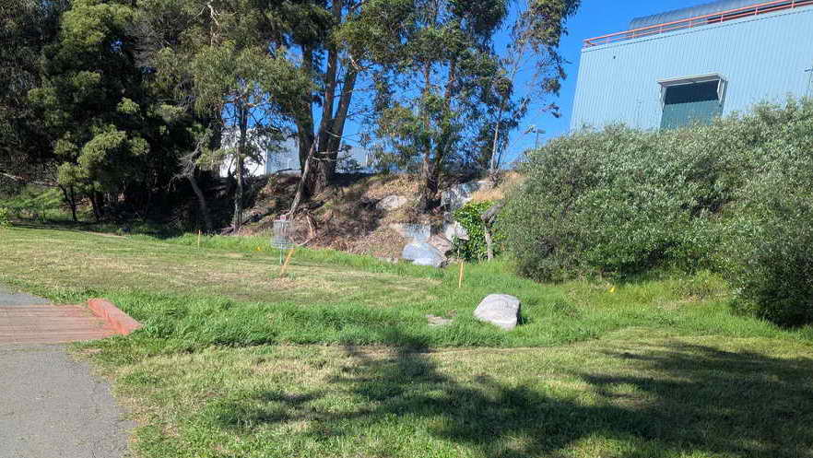
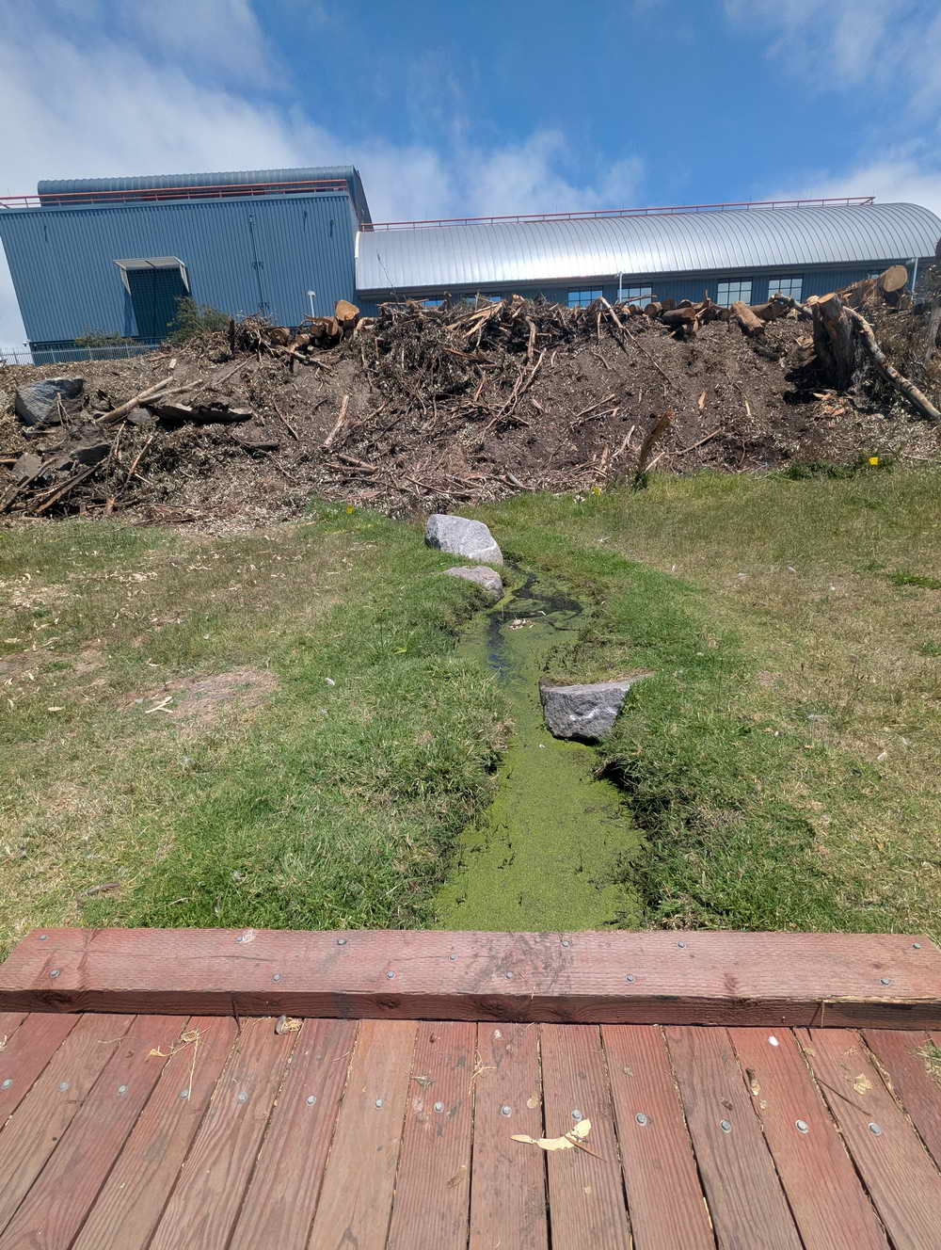
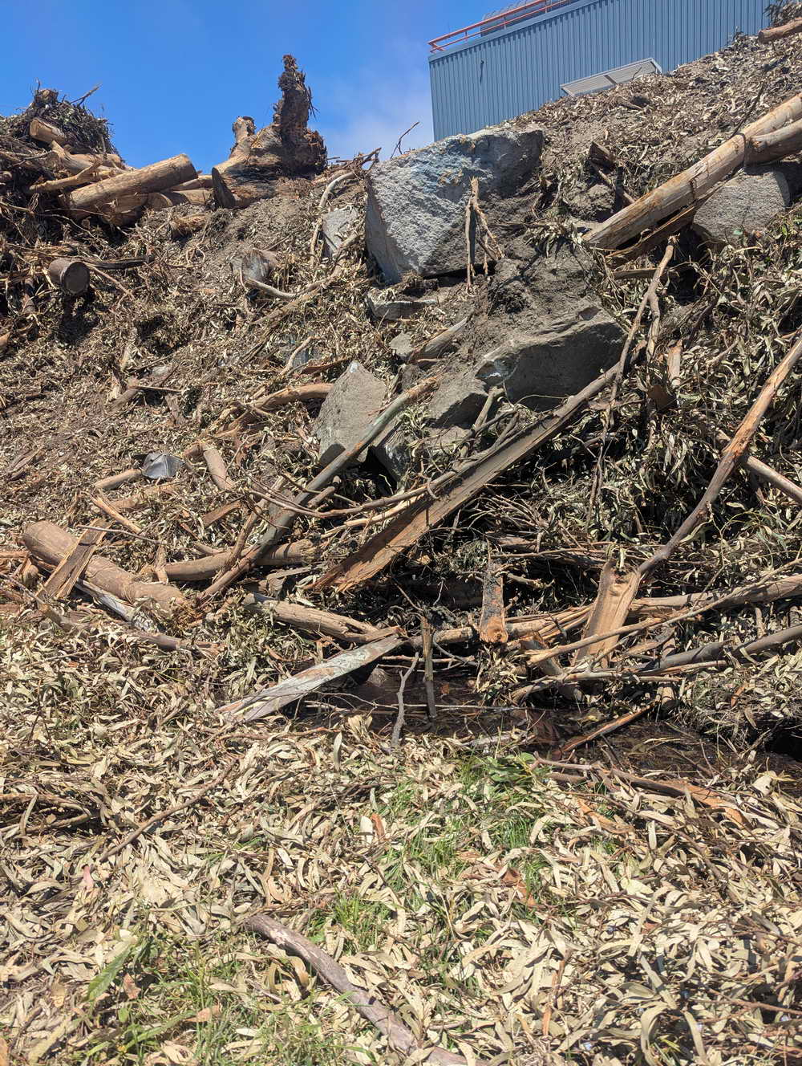
Left: Grayson “Creek,” only watercourse from the railroad to the Bay acknowledged in state and federal approvals.
State-approved water plans say it is to be protected by a short retaining wall, with plantings. Will this be after RR construction is complete, supposedly this summer?
Far left: all vegetation cut and more wood heaped on slope. Is this to prevent erosion?
Near left: The pool where the creek originated – pile of rocks in top photo – is partly buried. Ther rocks may have been a broken pipeline.
The city has rights to pipelines through the RR grade at most street ends. Some, as at Heinz, were originally tsewers. It is not clear that the city knows where they are.

Slide 4
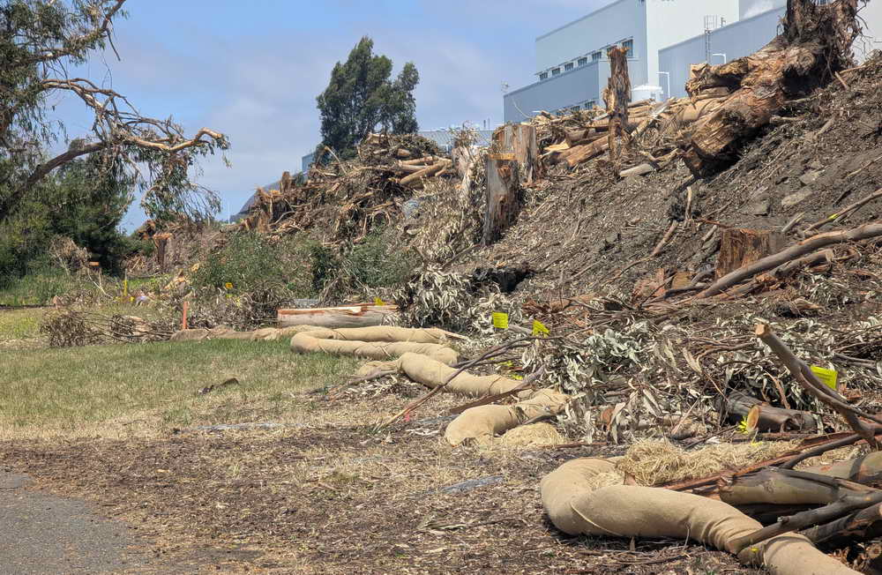
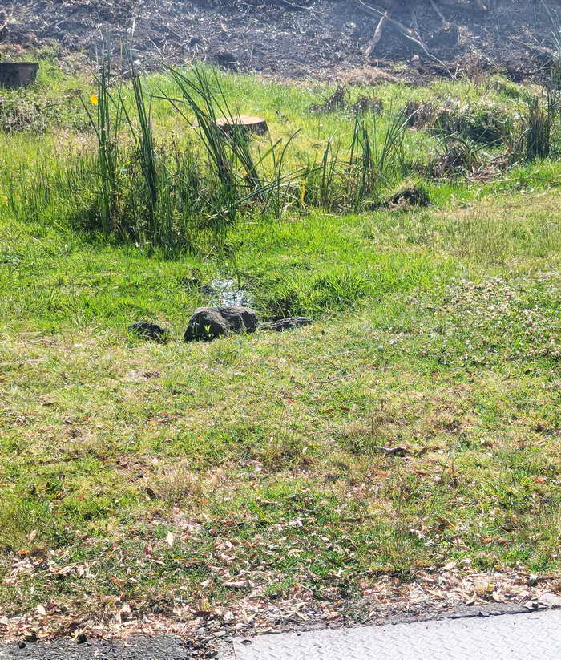
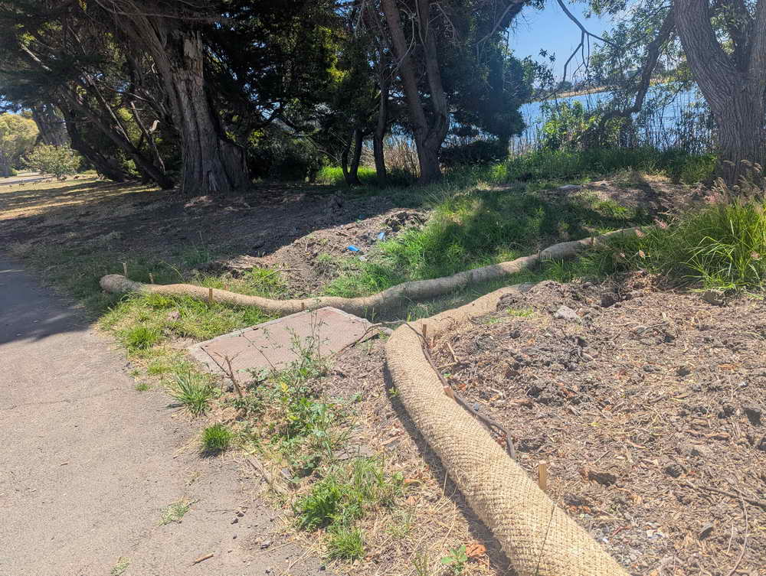
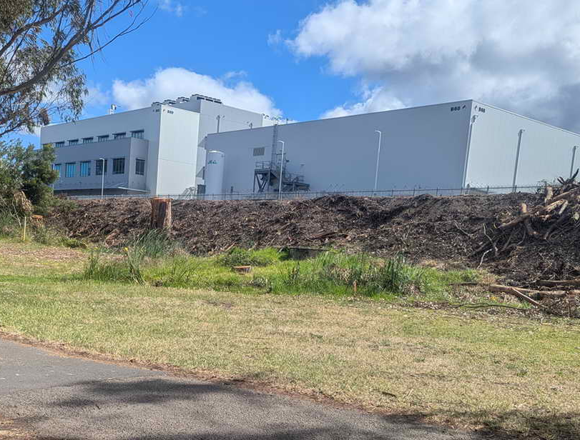
Left: heading south toward Carleton. How will the RR stabilize this very steep slope? How will the buried fuel line, marked with yellow flags, be protected?
Below: A spring, old tank (orange arrow), and short pipe near Carleton take runoff and groundwater to the lagoon. As can be seen, “Carleton Creek” gets little respect.
The RR grade is the old shoreline bluff. The park is the former Bay shore and mudflat. These wetlands and small creeks help purify runoff before it reaches the lagoon or Bay, doing for free what the city spends millions on as “rain gardens” or “bioswales.”

Slide 5
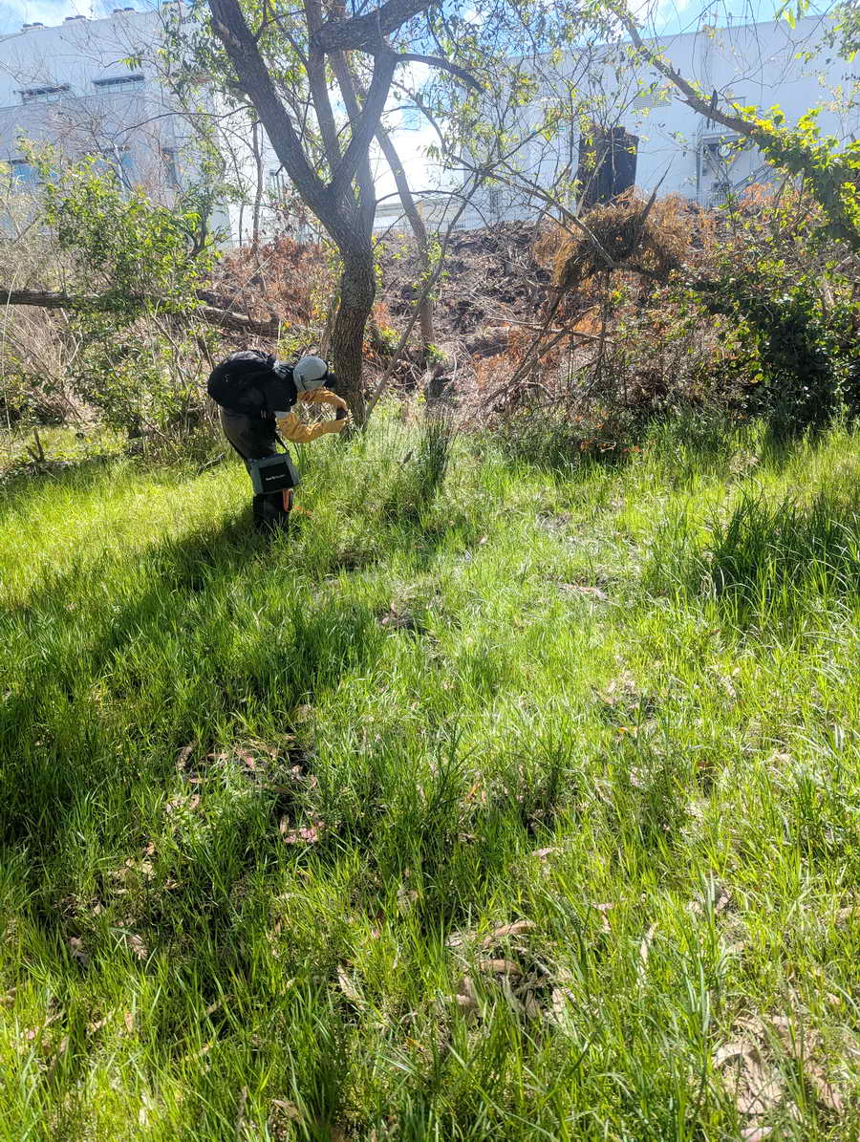
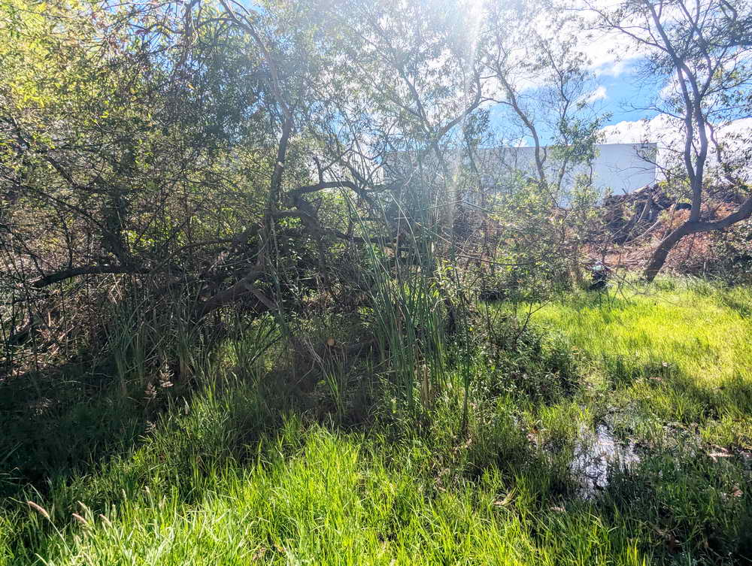
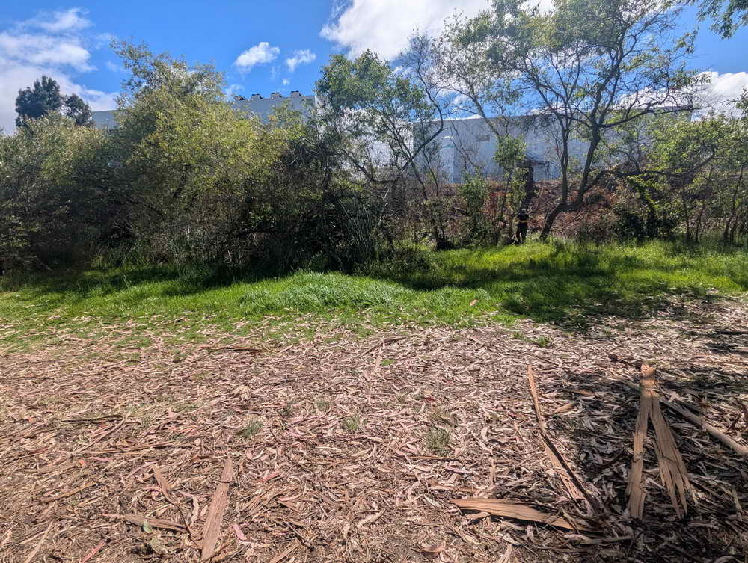
Seasonal wetlands get deeper and denser north toward west of Parker St.
Orange arrows mark the same tree.
Upper left, mud and a small channel remain in late June.
Center, a shallow pond in the lower left of photo.
Below right, chips dumped on a wet spot – probably short-sighted.

Slide 6
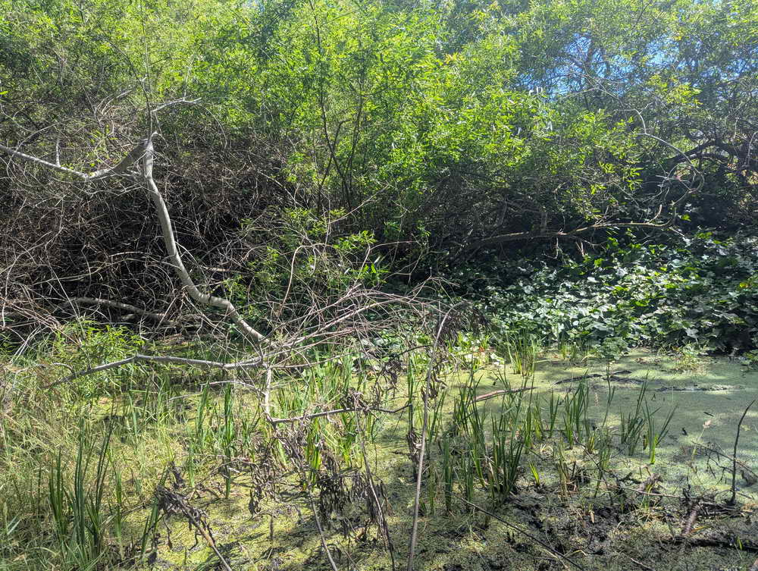
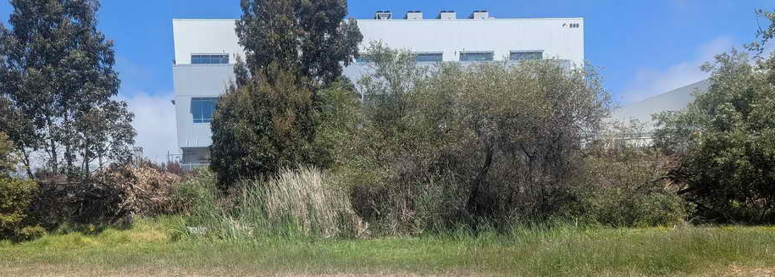
Left, a pond in the wetlands near Parker. Invertebrates feed herons and egrets that hunt in the cattails and rushes. Rushes and cattails offers shelter and nests. Duckweed, fast-growing and high in protein, feeds geese and ducks. Its shade helps keep water cool and algae-free. Willows draw songbirds and are almost an ecosystem in themselves, . Shake a branch --see what you find!
Below, the Parker wetlands end at another creeklet that wanders to the lagoon. Parks staff mow the cattails.

Slide 7
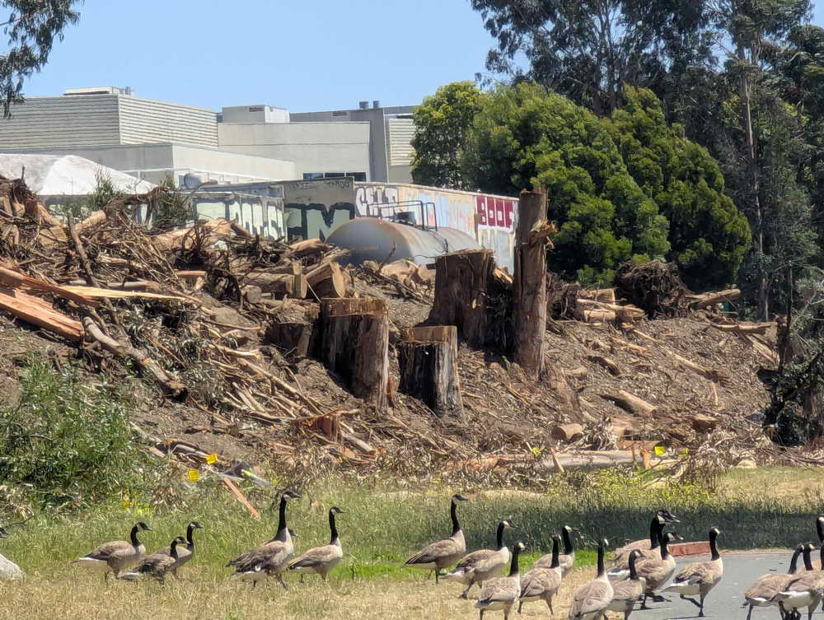
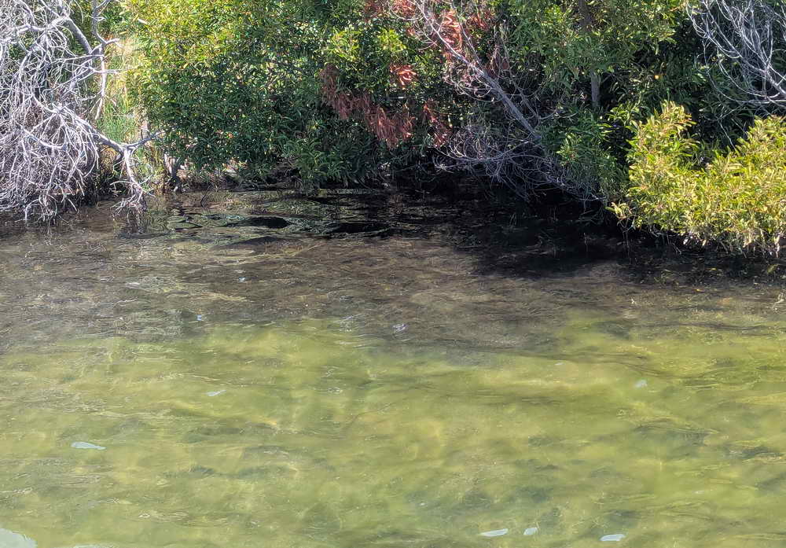
Left, Canada geese near Grayson. Right, scummy algae, looking toward shore from the historic pier a short distance north near Carleton.
Lagoons, parjkland around them, railroad grade, and nearby West Berkeley remain linked. Flocks of Canada geese delight in mowed grasslands. Their abundant droppings wash to the lagoons and fertilize scummy green algae. The algae smothers other life and fill the lagoons as it dies. More sun shining through shallow, warm water grows more algae. The cycle of eutrophication is not quite that simple, but the lagoons are slowly dying.

Slide 8
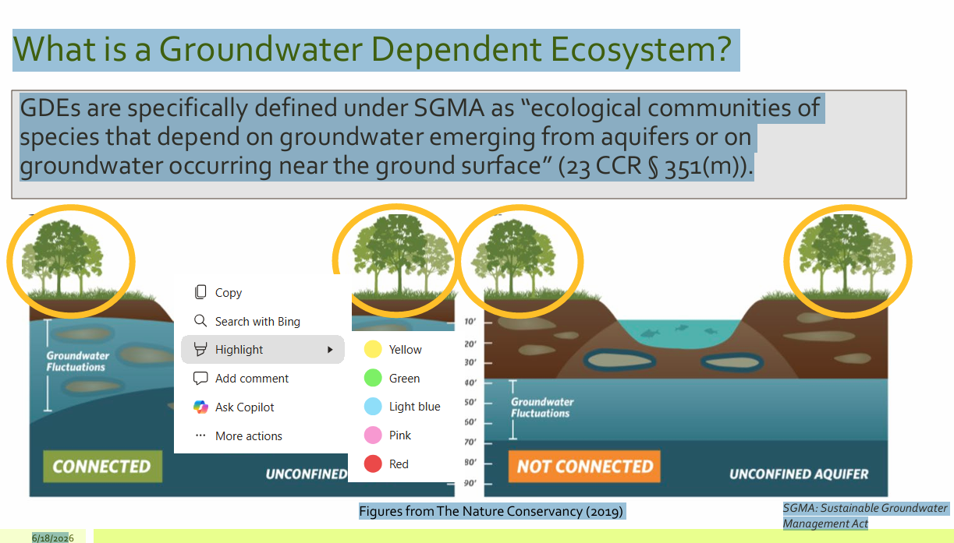
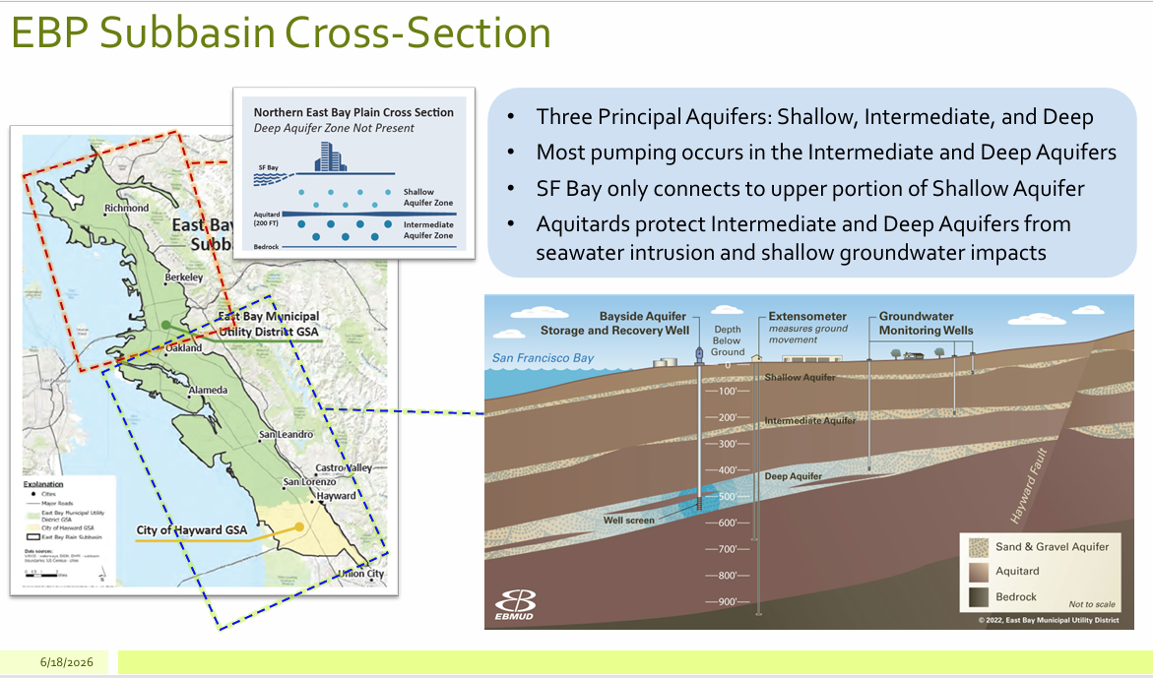
EB MUD calls Aquatic Pard a ‘Groundwater dependent ecosystem.” Water moves easily between rainfall or runoff, groundwater, and shallow aquifer. This water reaches the roots of plants and affects animal life. It rises and falls, pushes back and forth against saltier water of Bay and lagoons, and forms layers in the lagoons. These interactions will change and become more as sea levels rise.
Cross section of the East Bay Plain. The northern part, including Berkeley and Albany, has only a shallow aquifer connected to groundwater.
Graphics from EB MUD, but text and conclusions independent.

Slide 9
What do we need to know ?
Drainage from I 80 sends large volumes of runoff into the lagoons in rainy season. How much? How polluted? From where? What if anything could be done?
How are the tide gates managed, and not managed? Can they be managed to encourage more exchange during summer (keeping water cool and oxygenated)? Could they be managed to keep more polluted runoff and silt out in winter?
Why is Aquatic Park effectively ignored in the Regional Water Quality Control Board’s lists of impacted water bodies, and what could or should be done about this?
Public Works is supposed to be making a new plan for handling urban runoff. It basically refused to consider Aquatic Park. That plan is now late, and may include more information than we know. How do we find out? How can the city write such a plan and not consider the lagoons that keep West Berkeley from flooding?

